Slide 1
TRIPTOPIA
(Your basic trip planner)
Team Members:
Niranjana.J
Padmashree.J
Prathiksha.M

Slide 2
Abstract
This app acts as your official trip planner. Whether you’re planning on a vacation or an official trip, the app generates your personalized packing list based on destination, planned activities, transport and other personal needs.

Slide 3

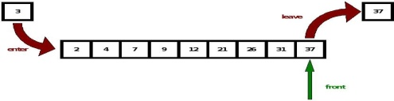
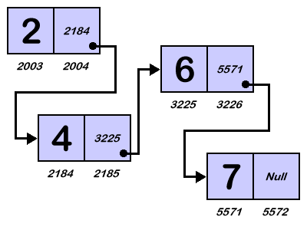

Architecture of the app
Stack : Checklist
Queue : For scheduling or traversing through each day
Doubly Linked list: To traverse through pages
Trees : To choose places and plans

